Slide 1

Bayesian Statistics: a whistle-stop tour
Lindsay F Banin
CEH Statistics & R Conference, 5th – 6th March 2018

Slide 2
Why be a Bayesian ecologist/environmental scientist?
“I like Bayesian approaches because they are conceptually easy. All you need to do is specify probability distributions for your data and for the parameters of your model. Then Bayes will tell what you can conclude and how much uncertainty remains.” Marcel van Oijen
“Because it’s the ultimate flexible tool for analysing your data – YOU get to decide how to ask the question you want and can match the complexity of your model to that of your data and your question. It’s the most intuitive approach to statistics I’ve ever come across, and therefore easier than other methods…………[And of course, because it’s just plain badass!]” Kate Searle
Notes:
Why learn Bayesian stats – it’s hard, isn’t it?

Slide 3
Why be a Bayesian ecologist/environmental scientist?
What is the probability that this hypothesis is true?
As opposed to: What is the probability of observing the data given the hypothesis is true?
What is the probability a parameter will take a value within a specified interval?
As opposed to: If I repeat data collection many, many times, and construct 95% CIs of the mean each time, 95% of intervals would encompass the true mean
Relevant prior information can be incorporated in Bayesian approaches. Conventional statistics methods ignore any information other than in the data
Notes:
Conceptually - enables to answer questions relevant to us. Nicely summarised in introductory chapter of McCarthy 2007. “Bayesian methods can be used to make probabilistic predictions about the state of the world, while conventional statistics are restricted to statements about long-run averages obtained from hypothetical replicates of sampled data”.

Slide 4
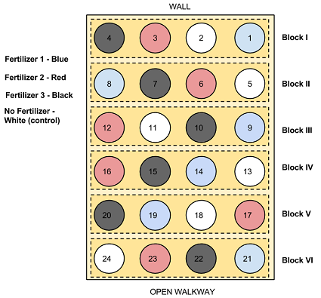
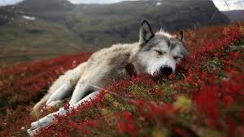
Why be a Bayesian ecologist/environmental scientist?
Flexibility:
Combining data from different sources
Modelling data collected at different scales, sampling methods, temporally/spatially misaligned data
Unbalanced designs, missing data
Multiple sources of uncertainty
Forecasting, projecting uncertainty
Notes:
Practical problems – frequent in observational env sci data. Our data often aren’t from neatly designed experiments.

Slide 5
Bayes ‘101’
4 components of knowledge (McCarthy 2007)
(model)
Prior + Data → Posterior
Notes:
What is it? We can summarise Bayesian analyses like this - Bayesian methods recognise and combine 4 components of knowledge.

Slide 6
Bayes ‘101’
(model)
Prior + Data → Posterior
For unobserved quantities (θ), and observed data X:
POSTERIOR DISTRIBUTION
Probability of θ given data
P(θ | X) = (P(X | θ) P(θ))/P(X)
MARGINAL DISTRIBUTION
Of data X
LIKELIHOOD OF DATA given θ
PRIOR DISTRIBUTION
Probability for θ
Notes:
Derived from conditional probability (Hobbs & Hooten, McCarthy for accessible intros).

Slide 7
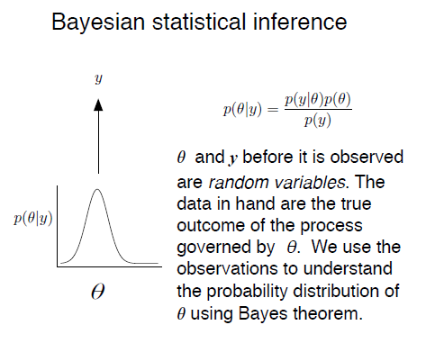
All unobserved quantities (θ) are treated the same way:
Model parameters
Missing data
Predictions/forecasts
Latent states
Data (before they are observed)
Notes:
For each of these things, we get a probability distribution. This estimate of uncertainty is useful!

Slide 8
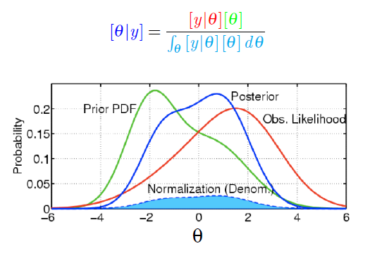
Bayes ‘101’
(model)
Prior + Data → Posterior
Notes:
In practice, the more vague your prior, the closer your posterior will be to your likelihood, and approach the same result as a maximum likelihood analysis.

Slide 9
Bayes ‘101’
(model)
Prior + Data → Posterior
Notes:
Only the simplest models can be calculated analytically – this integral is tricky, hence the use of numerical methods.

Slide 10
Sample-based estimation
Numerical methods to approximate the posterior distribution, avoiding the need to integrate the marginal distribution
Algorithms to sample the unknown quantities from the posterior
Markov chain Monte Carlo sampling (MCMC)
If we know the full conditional distribution (i.e. conjugate distributions) we can use a Gibbs sampler; if not use an accept/reject sampler e.g. Metropolis-Hastings
MCMC uses likelihood profile and priors to generate many random samples, proportionate to their density
Inference drawn from summarising histogram (e.g. mean, standard deviation, percentiles)
Notes:
There are other modes of estimation but MCMC most commonly used. Using MCMC, it is not necessary to calculate the denominator in Bayes rule because each successive sample depends on the ratio of 2 posterior probabilities that share the same denominator (which cancels), so the Bayesian analysis only requires the prior probability and likelihood of data.

Slide 11
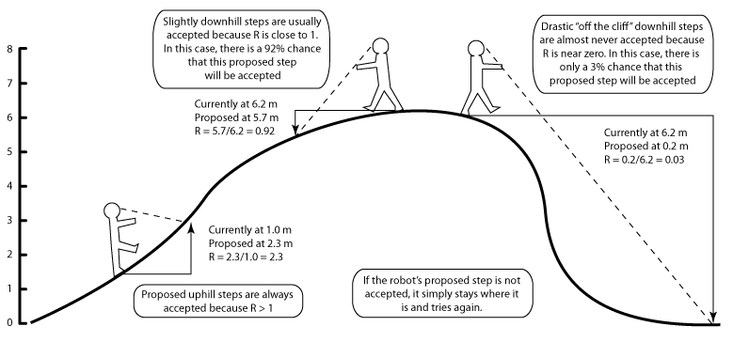
http://mcmcrobot.org/
Notes:
Useful tool for learning sampler algorithm basics

Slide 12
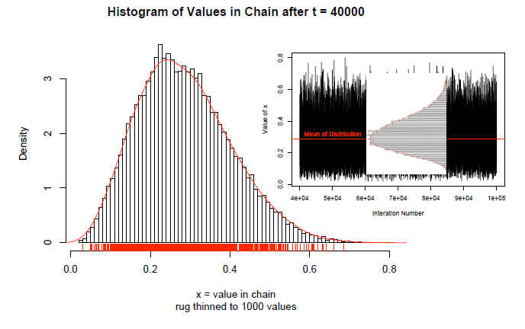
What do we get? For each unknown:
Notes:
We choose starting values, burn-in, length of simulations.

Slide 13
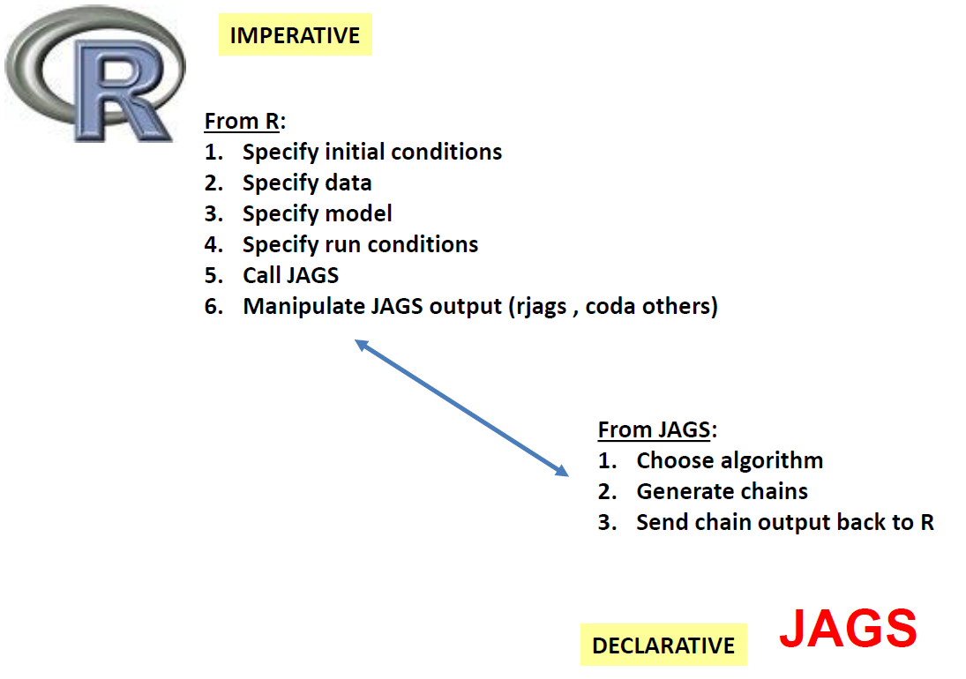
R & JAGS
(Just another Gibbs Sampler)
Notes:
How do we get it? Generate own sampler or BUGS language (Bayesian Analysis Using Gibbs Sampler) E.g. OpenBUGS, WinBUGS, JAGS
Different strengths – JAGS not so good for spatial data, but more flexible and don’t need to point-and-click using GUI and better for collaboration as also works on mac and Linux systems

Slide 14
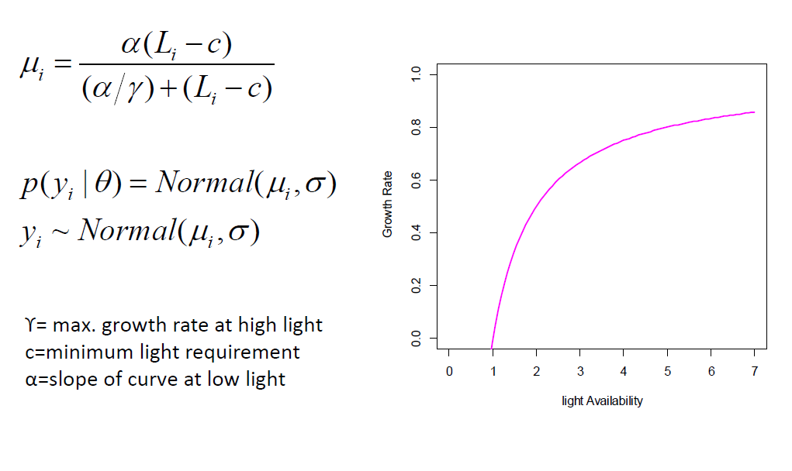
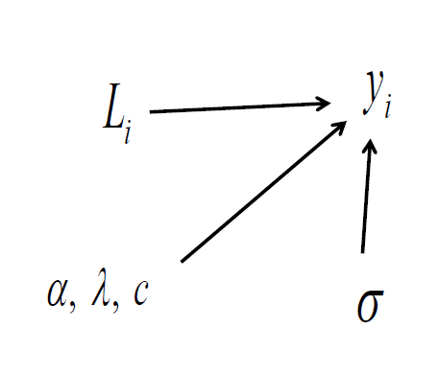
Example
Directed Acyclic Graph
Notes:
Simple model of plant growth given light availability. Specify this model in JAGS software.

Slide 15
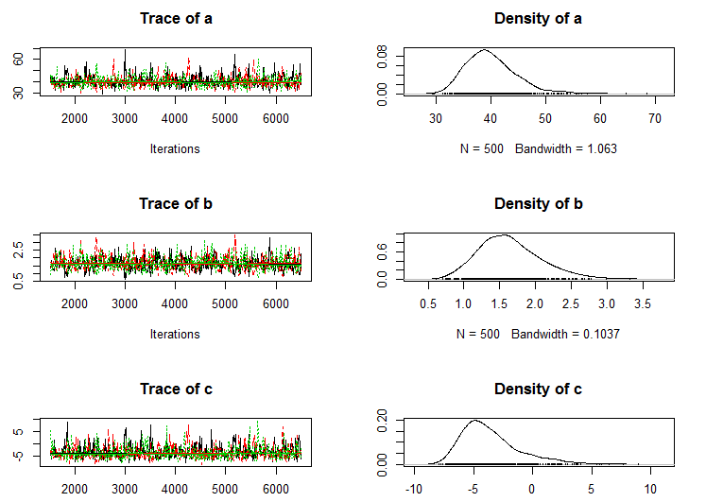
Example output
Notes:
NB thin = 10. Chain gives value for each sample – summarise as a probability distribution.

Slide 16
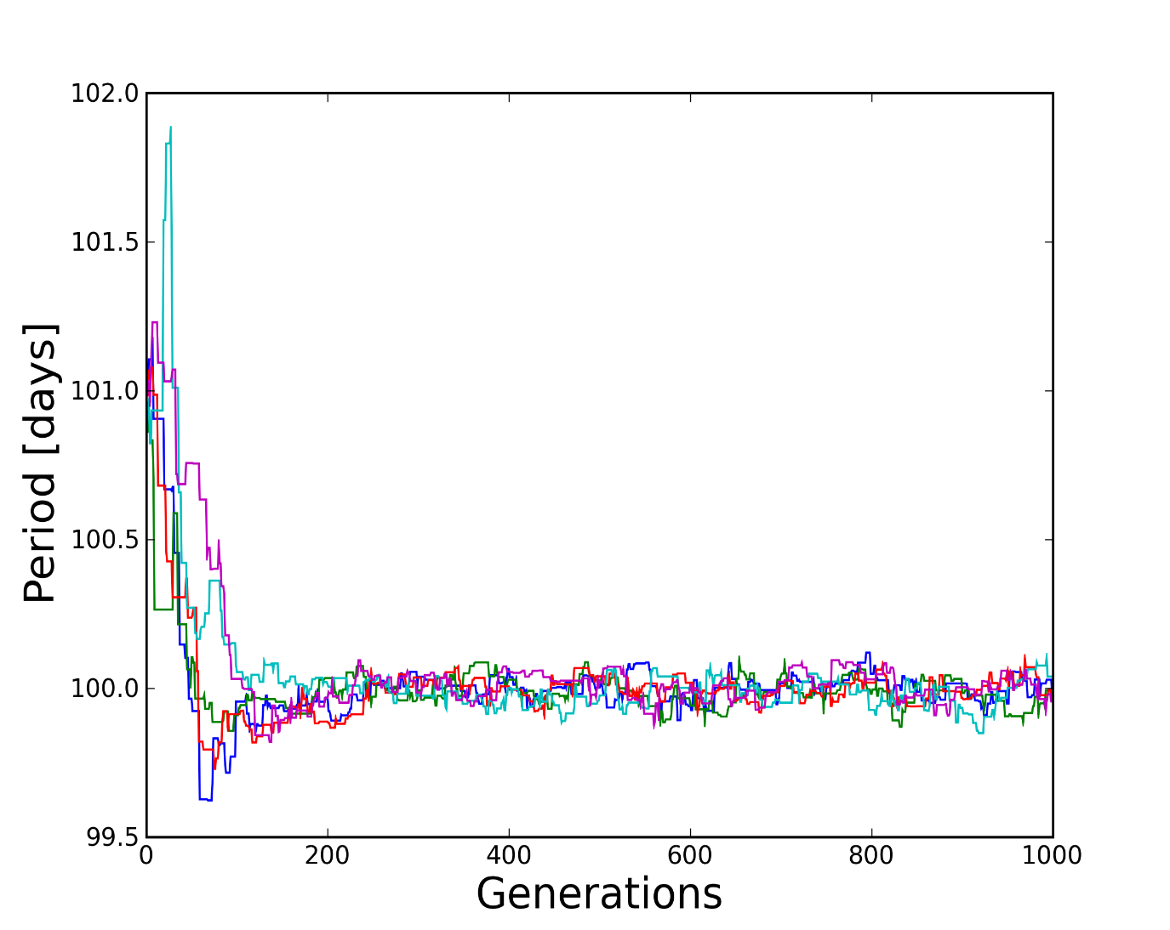
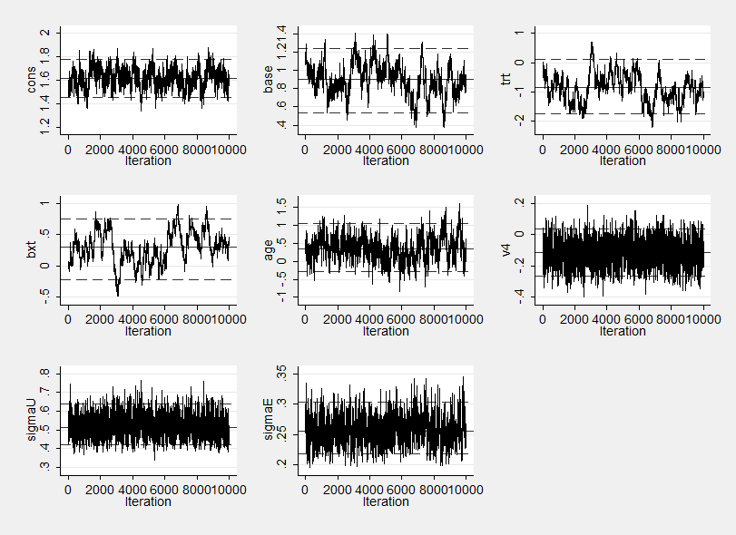
Model evaluation
Assessing convergence
Visually: mixing, burn-in
http://staffblogs.le.ac.uk/bayeswithstata/2015/02/13/
Notes:
Mixing related to autocorrelation

Slide 17
Model evaluation
Assessing convergence – i.e. adding more samples will not meaningfully change the parameter approximations
Visually: burn-in, mixing (not getting stuck in local max/min)
Heidlberger and Welch diagnostic (1983) – stationarity and half width mean. Helps ascertain burn-in
Convergence statistics (e.g. Gelman-Rubin 1992), e.g. run 3 chains and compare within vs between chain variance – i.e. outputs from chains are indistinguishable

Slide 18
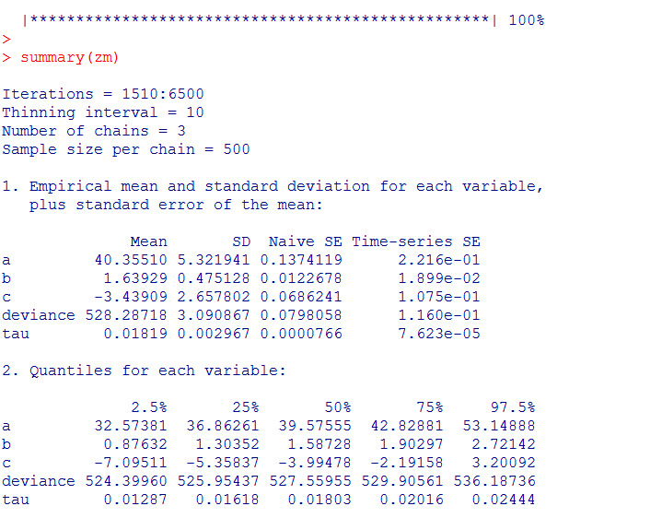
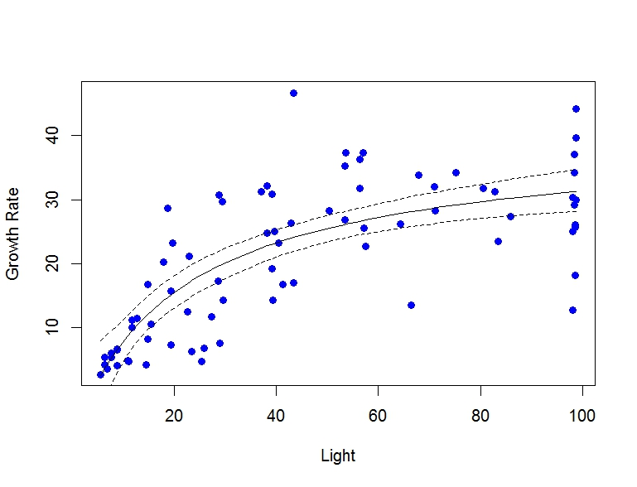
Inference
Notes:
Central tendency, credible intervals
i.e. the value of the parameter lies in that range, with a given probability (credible intervals) e.g. 95% chance a sample falls within that range

Slide 19
Posterior predictive checks
NB each prediction also has a probability distribution (posterior predictive distribution)
Observed vs predicted
Bayesian p-values
Out-of-sample prediction and validation
Multi-model inference/selection - DIC
Notes:
See day 5 PM lab

Slide 20

Applying a Bayesian approach
Directed acyclic graphs (DAGs)
Gibbs samplers, e.g. JAGS/BUGS
Multi-model inference/comparison
Hobbs & Hooten 2015

Slide 21
Resources
Hobbs & Hooten (2015)
McCarthy (2007)
Ellison (2004) Ecology Letters
Ogle & Barber (2012) Bayesian statistics. In Encyclopaedia of Theoretical Ecology
http://mcmcrobot.org/

Slide 22
For tomorrow’s practical…
Check you are running a recent version of R
Install ‘rjags’ package in R
Go to http://sourceforge.net/projects/mcmc-jags/files/JAGS/. Click on Windows and then the JAGS executable (exe file).
Running multiple versions of R on your computer may cause problems!

Slide 24
Prior distributions
Informative priors – expert opinion; previous studies; intervals; expressions of uncertainty
Proper priors (i.e. area under curve integrates to 1)
Vague priors (a.k.a. flat, diffuse; at the beginning of your analysis, plot your priors to check they make sense and genuinely are vague)
Shape of prior becomes less influential and likelihood more influential with increasing sample size
Conjugacy – allows more straight forward solution
Support – what values are logical given the nature of the data?

